Slide 1


Chenyu GAO
July 2025

Slide 2

Outline
Executive Summary
Introduction
Methodology
Results
Conclusion
Appendix

Slide 3
Executive Summary
Summary of methodologies
Data collection
Data wrangling
Exploratory Data Analysis with Data Visualization
Exploratory Data Analysis with SQL
Building an interactive map with Folium
Building a Dashboard with Plotly Dash
Predictive analysis (Classification)
Summary of all results
Exploratory Data Analysis results
Interactive analytics demo in screenshots
Predictive analysis results

Slide 4
Introduction
Project background and context
SpaceX is the most successful company of the commercial space
age, making space travel affordable. We would like to determine if the first stage will land, we can determine the cost of a launch. Based on public information and machine learning
models, we are going to predict if SpaceX will reuse the first stage.
Problems you want to find answers
How do variables such as payload mass, launch site, number of flights, and orbits affect the success of the first stage landing?
What is the best algorithm that can be used for binary classification in this case?

Slide 5

Section 1

Slide 6
Methodology
Executive Summary
Data collection methodology
- Using SpaceX Rest API
- Using Web Scraping from Wikipedia
Performed data wrangling
- Filtering the data
- Dealing with missing values
- Using One Hot Encoding to prepare the data to a binary classification
Performed exploratory data analysis (EDA) using visualization and SQL
Performed interactive visual analytics using Folium and Plotly Dash
Performed predictive analysis using classification models
- Building, tuning and evaluation of classification models to ensure the best results

Slide 7
Data Collection
Data collection process involved a combination of API requests from Space X public API and web scraping data from a table in Space X’s Wikipedia entry ：
Space X API Data
Wikipedia Webscrape Data

Slide 8
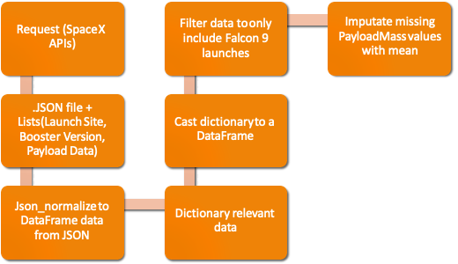
Data Collection – SpaceX API
https://github.com/Chen-G07/Coursera/blob/main/Applied%20Data%20Science%20Capstone%20Projet/Lab%201%20Collecting%20the%20data.ipynb

Slide 9
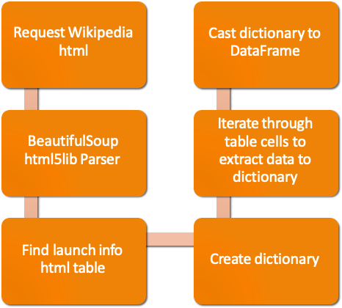
Data Collection - Scraping
https://github.com/Chen-G07/Coursera/blob/main/Applied%20Data%20Science%20Capstone%20Projet/Data%20Collection%20with%20Web%20Scraping.ipynb

Slide 10
Data Wrangling
Create a training label with landing outcomes where successful = 1 & failure = 0
Outcome column has two components: ‘Mission Outcome’ ‘Landing Location’
New training label column ‘class’ with a value of 1 if ‘Mission Outcome’ is True and 0 otherwise
https://github.com/Chen-G07/Coursera/blob/main/Applied%20Data%20Science%20Capstone%20Projet/Lab%202%20Data%20wrangling.ipynb

Slide 11
EDA with Data Visualization
Plots Used:
Flight Number vs. Payload Mass, Flight Number vs. Launch Site, Payload Mass vs. Launch Site, Orbit vs. Success Rate, Flight Number vs. Orbit, Payload vs Orbit, and Success Yearly Trend
Scatter plots, line charts, and bar plots were used to compare relationships between variables to decide if a relationship exists so that they could be used in training the machine learning model
https://github.com/Chen-G07/Coursera/blob/main/Applied%20Data%20Science%20Capstone%20Projet/EDA%20with%20Visualization.ipynb

Slide 12
EDA with SQL
https://github.com/Chen-G07/Coursera/blob/main/Applied%20Data%20Science%20Capstone%20Projet/SQL%20Notebook%20for%20Peer%20Assignment.ipynb
Display the names of the unique launch sites in the space mission
Display 5 records where launch sites begin with the string 'CCA'
Display the total payload mass carried by boosters launched by NASA (CRS)
Display average payload mass carried by booster version F9 v1.1
List the date when the first successful landing outcome in ground pad was achieved
List the names of the boosters which have success in drone ship and have payload mass greater than 4000 but less than 6000
List the total number of successful and failure mission outcomes
List all the booster_versions that have carried the maximum payload mass, using a subquery with a suitable aggregate function.
List the records which will display the month names, failure landing_outcomes in drone ship ,booster versions, launch_site for the months in year 2015
Rank the count of landing outcomes (such as Failure (drone ship) or Success (ground pad)) between the date 2010-06-04 and 2017-03-20, in descending order

Slide 13
Build an Interactive Map with Folium
Folium maps mark Launch Sites, successful and unsuccessful landings, and a proximity example to key locations: Railway, Highway, Coast, and City.
https://github.com/Chen-G07/Coursera/blob/main/Applied%20Data%20Science%20Capstone%20Projet/Interactive%20Visual%20Analytics%20with%20Folium.ipynb

Slide 14
Build a Dashboard with Plotly Dash
Dashboard includes a pie chart and a scatter plot ：
The pie chart is used to visualize launch site success rate
The scatter plot can help us see how success varies across launch sites, payload mass, and booster version category
https://github.com/Chen-G07/Coursera/blob/main/Applied%20Data%20Science%20Capstone%20Projet/Build%20an%20Interactive%20Dashboard%20with%20Plotly%20Dash.py

Slide 15
Predictive Analysis (Classification)
https://github.com/Chen-G07/Coursera/blob/main/Applied%20Data%20Science%20Capstone%20Projet/Machine%20Learning%20Prediction.ipynb

Slide 16
Results
Exploratory data analysis results
Interactive analytics demo in screenshots
Predictive analysis results

Slide 17

Section 2

Slide 18
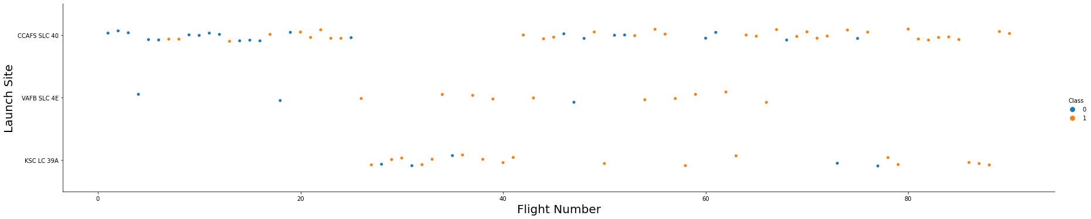
Flight Number vs. Launch Site
Explanation:
• The CCAFS SLC 40 launch site has about a half of all launches.
• VAFB SLC 4E and KSC LC 39A have higher success rates.

Slide 19
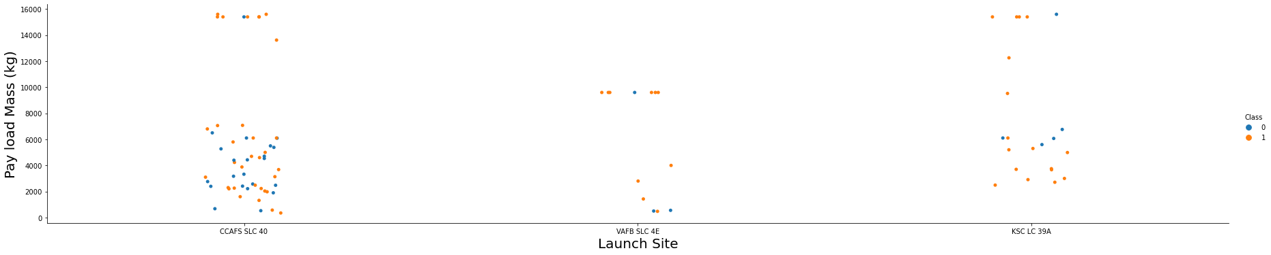
Payload vs. Launch Site
Explanation:
• Most of the launches with payload mass over 8000 kg were successful.

Slide 20
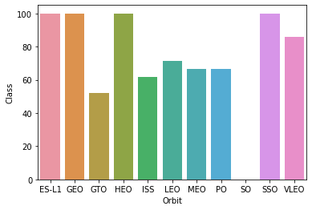
Success Rate vs. Orbit Type
Explanation:
• Orbits with 100% success rate: ES-L1, GEO, HEO, SSO
• Orbits with 0% success rate: SO
• Orbits with success rate between 50% and 85%: GTO, ISS, LEO, MEO, PO

Slide 21
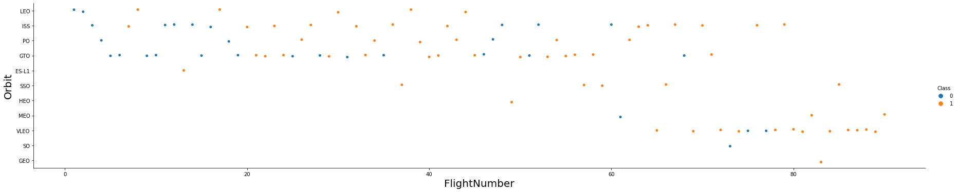
Flight Number vs. Orbit Type
Explanation:
• There seems to be no relationship between flight number when in GTO orbit.

Slide 22
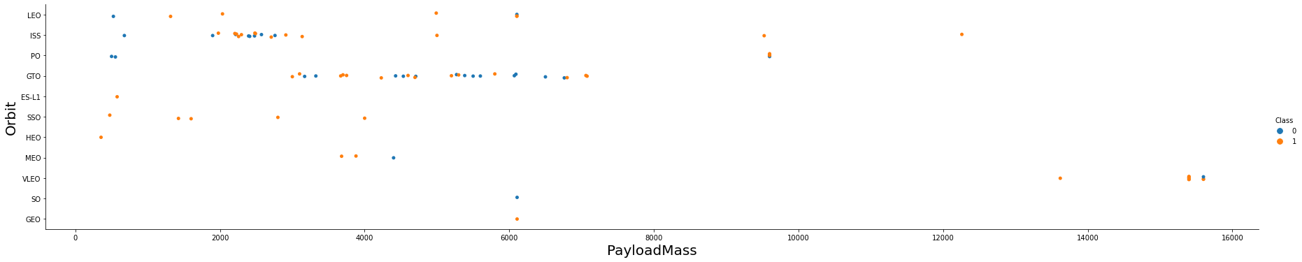
Payload vs. Orbit Type

Slide 23
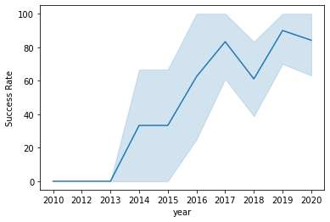
Launch Success Yearly Trend

Slide 24
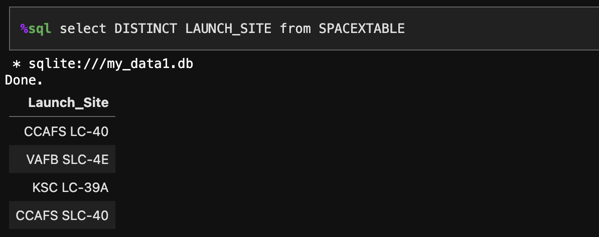
All Launch Site Names

Slide 25
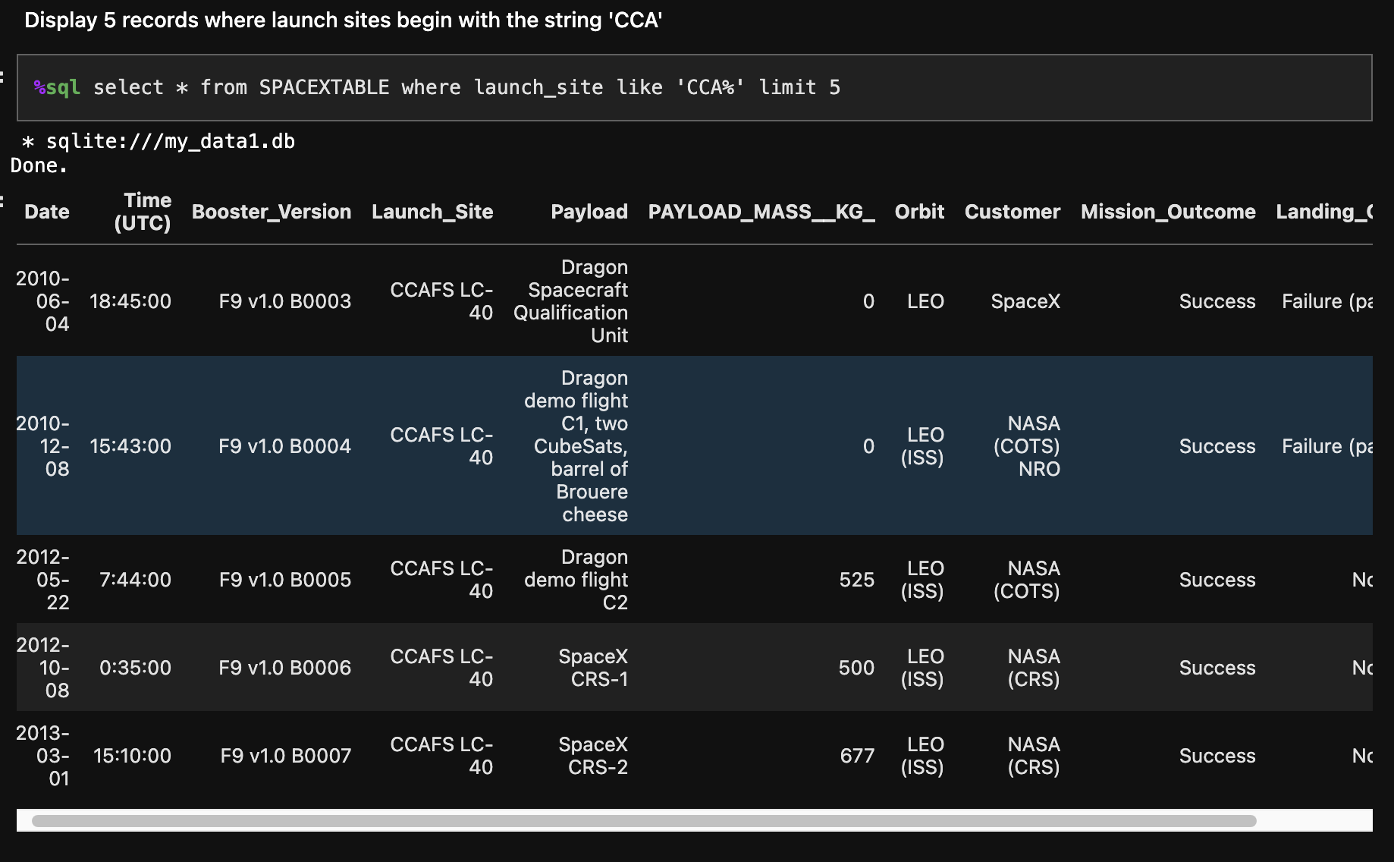
Launch Site Names Begin with 'CCA'

Slide 26
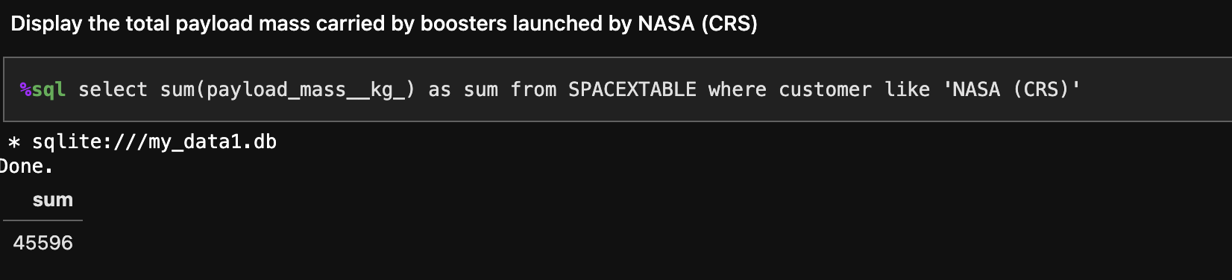
Total Payload Mass

Slide 27
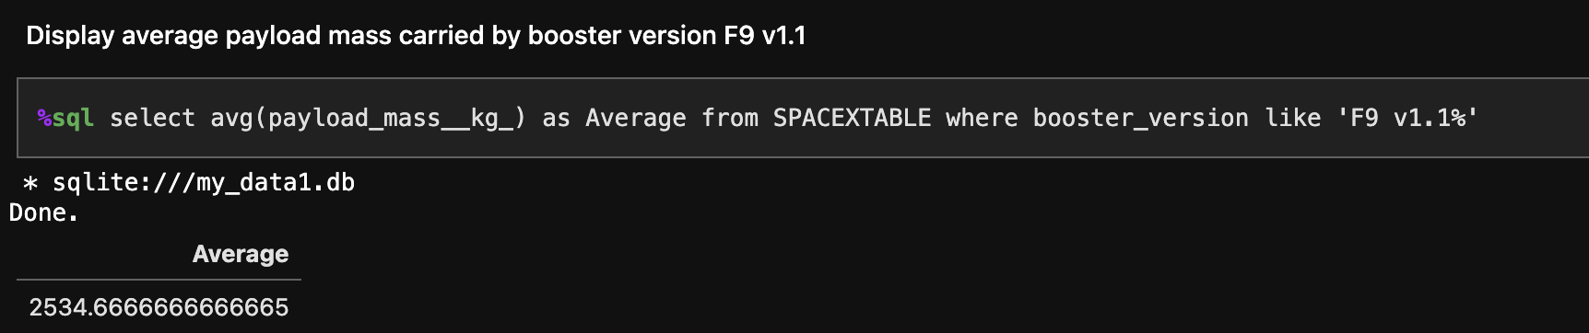
Average Payload Mass by F9 v1.1

Slide 28
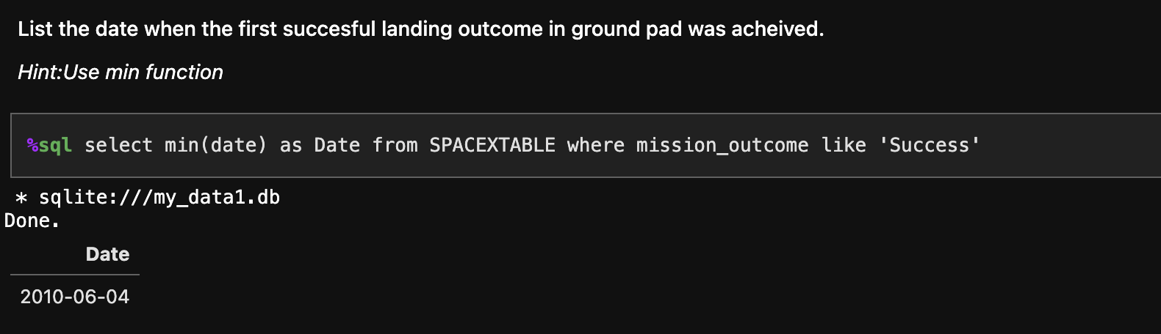
First Successful Ground Landing Date

Slide 29
Successful Drone Ship Landing with Payload between 4000 and 6000

Slide 30
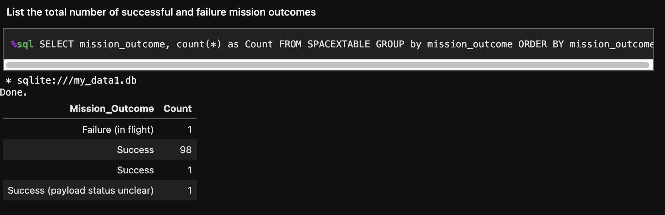
Total Number of Successful and Failure Mission Outcomes

Slide 31
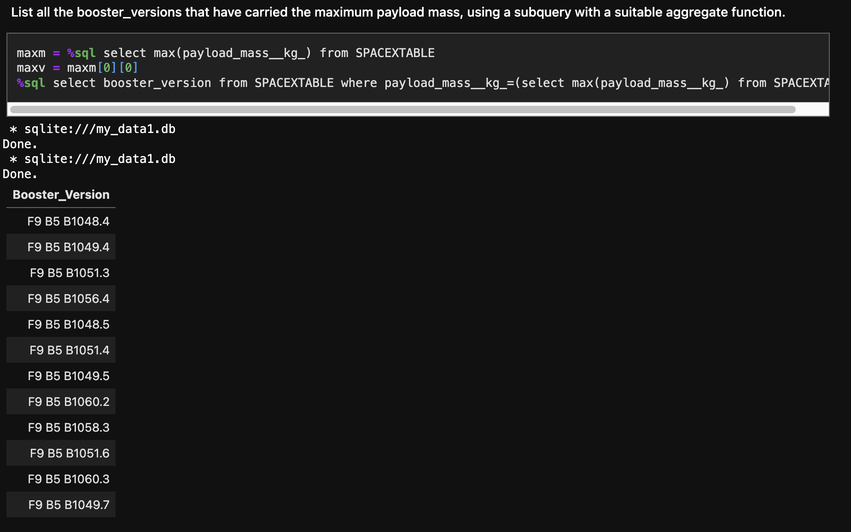
Boosters Carried Maximum Payload

Slide 32
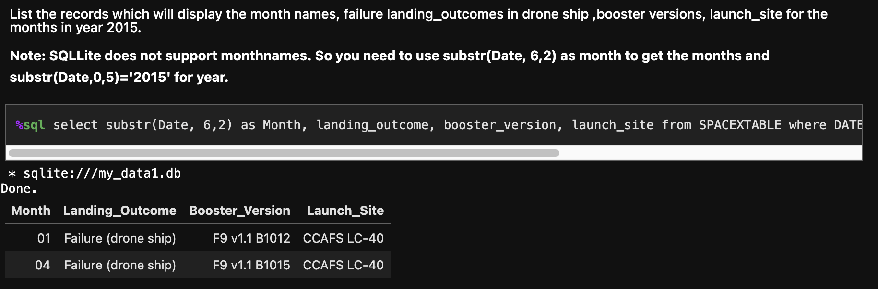
2015 Launch Records

Slide 33
Rank Landing Outcomes Between 2010-06-04 and 2017-03-20

Slide 34

Section 3

Slide 35

<Folium Map Screenshot 1>

Slide 36

<Folium Map Screenshot 2>

Slide 37

<Folium Map Screenshot 3>

Slide 38

Section 4

Slide 39
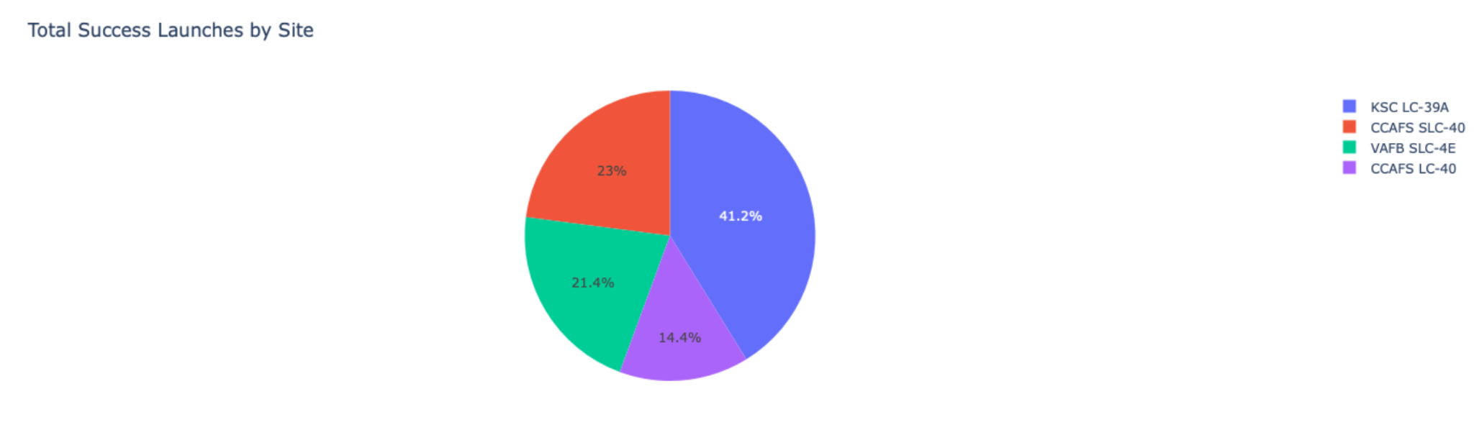
<Dashboard Screenshot 1>

Slide 40
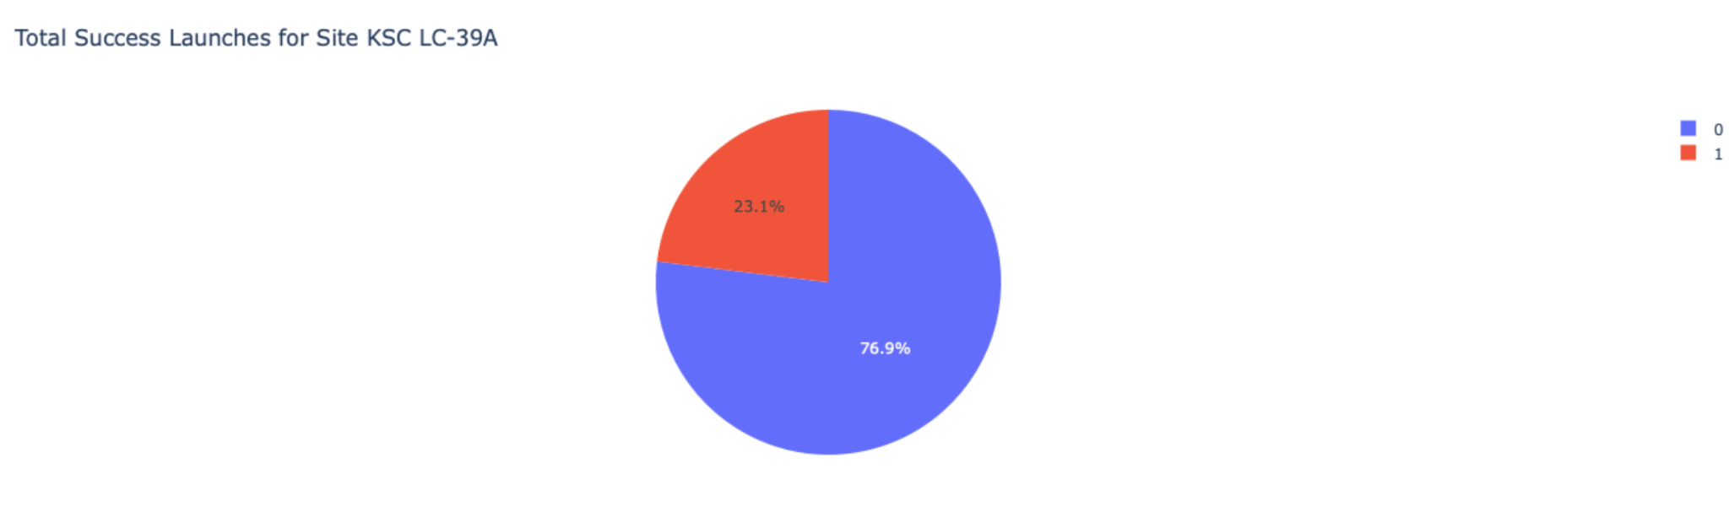
<Dashboard Screenshot 2>

Slide 41
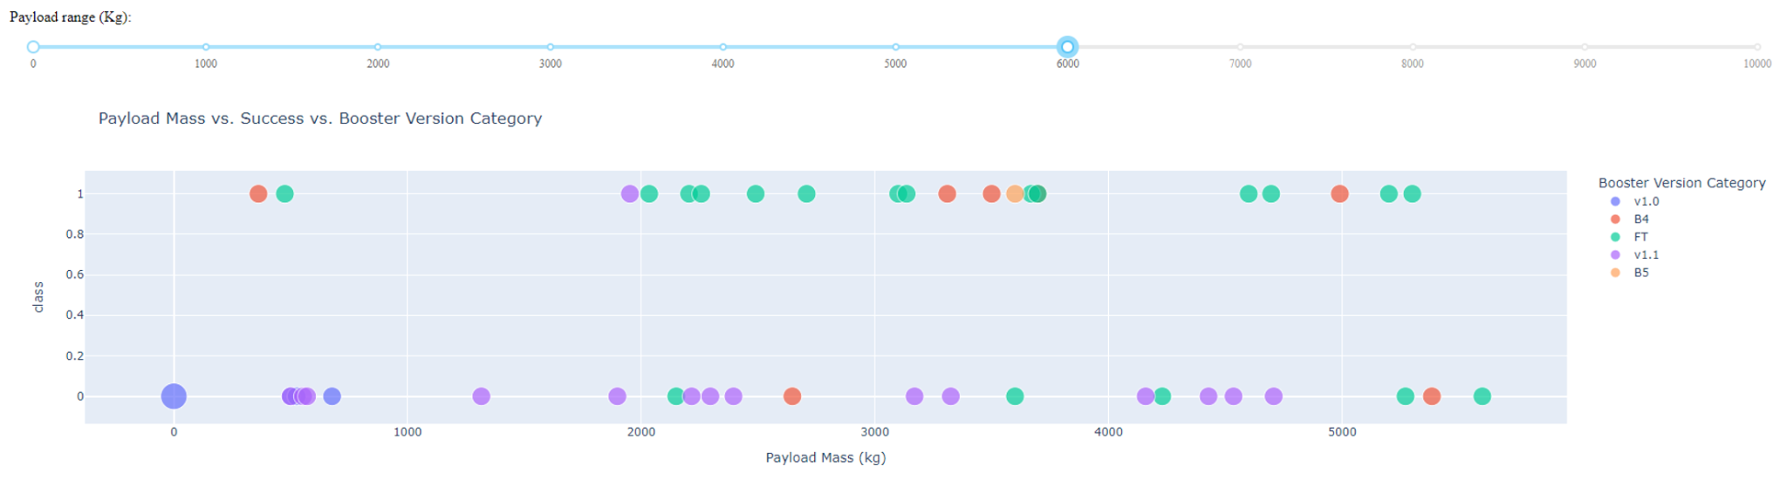
<Dashboard Screenshot 3>

Slide 42

Section 5

Slide 43
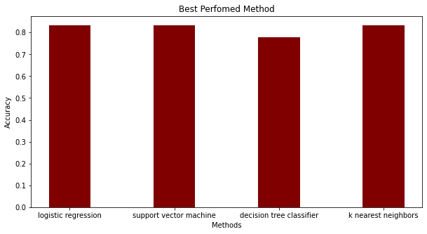
Classification Accuracy
Visualize the built model accuracy for all built classification models, in a bar chart
Find which model has the highest classification accuracy

Slide 44
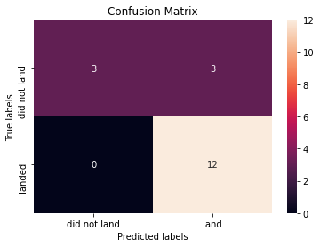
Confusion Matrix
Show the confusion matrix of the best performing model with an explanation

Slide 45
Conclusions
The CCAFS SLC 40 launch site has about a half of all launches.
VAFB SLC 4E and KSC LC 39A have higher success rates.
Most of the launches with payload mass over 8000 kg were successful.
…

Slide 46
Appendix
THANK YOU !
PROFESSORS
COURSERA
REVIEWER

Slide 47


